Slide 1

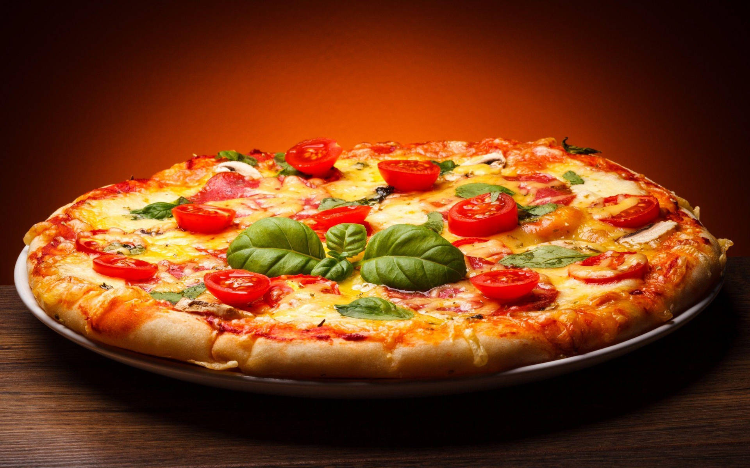
------------
Pizza Hut, LLC

Slide 2

ABOUT US

Slide 3

01
Subsidiary Brand
Parent company: Yum Brands
02
Industry : Restaurants
.
03
Headquarters : Plano, Texas
04
Founders : Dan Carney
Frank Carney

Slide 4
Timeline
2028
1977
2023
Planning to open 2500 more stores in West Asia, Africa, and South American Region
1958
2017
Currently Operating more than 19,866 stores in more 110 countries
Listed at Number 24 in the list of 200 Most influential Brands in the World
Acquired by PepsiCo, Later rebranded as Yum Brands
Founded on 31 May 1958, 65 years ago in Wichita, Kansas, USA
.

Slide 5
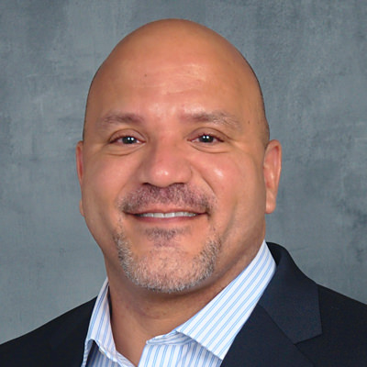


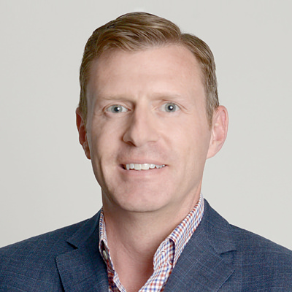
Our Team
Aaron Powell
Alan Eldhose
Tracy Skeans
Scott Catlett
Chief Executive Officer
Chief Financial Officer
.
Chief Operating Officer
Corporate Secretary

Slide 6
Vision & Mission
Vision
To reach the top of the peak to provide the best service and taste & To see Yum on the customer’s face.
Mission
To take pride in making the perfect pizza while providing courteous, helpful service at all times, striving to have every customer say that they plan to be back. We are accountable for profitability in everything we do, providing our shareholders with value growth.

Slide 7
U S P
building the world’s most-loved, trusted and fastest-growing restaurant brands for today and tomorrow. We’re doing so by following a mindful recipe: one with Good priorities that influence long-term Growth, and Growth drivers that accelerate the Good we can accomplish. This recipe continues to evolve alongside the changing needs of our employees, franchisees and other stakeholders.

Slide 8
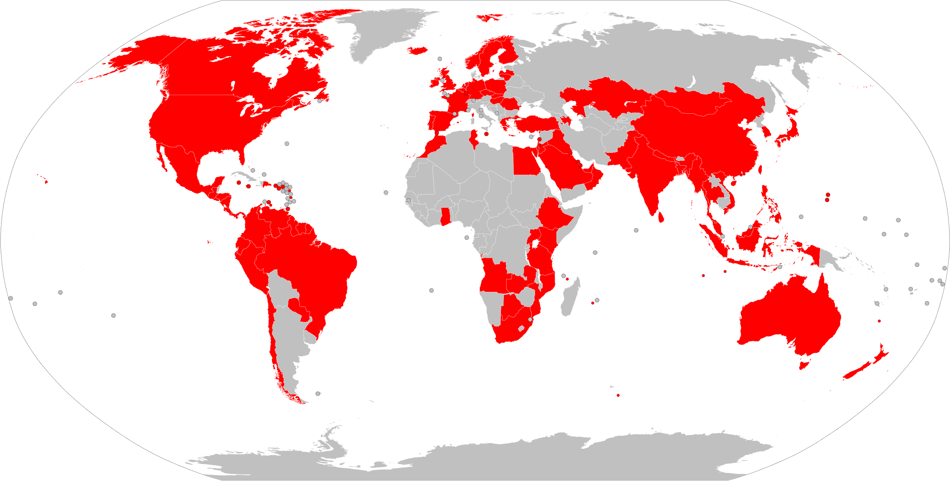
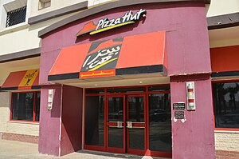
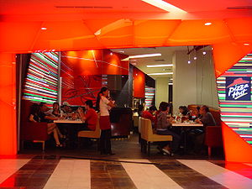
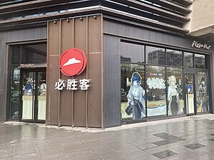
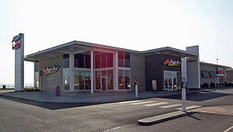
World Wide Presence
Riyadh, Saudi Arabia
Jakarta, Indonesia
Xi’an, China
Kingston, UK

Slide 9

S W O T
A N A L Y S I S

Slide 10

SWOT Analysis
THREATS
STRENGTH
Health Consciousness
Competition
Increasing Cost
Worldwide Reach
Innovation
Sponsorship
Country-wise menu
THREATS
STRENGTH
OPPORTUNITIES
OPPORTUNITIES
WEAKNESS
WEAKNESS
Developing Market
New flavors
Advertising.
Brand Franchise
No Variation

Slide 11



Rivalries
Domino’s Pizza
Papa John’s Pizza
McDonald’s

Slide 12

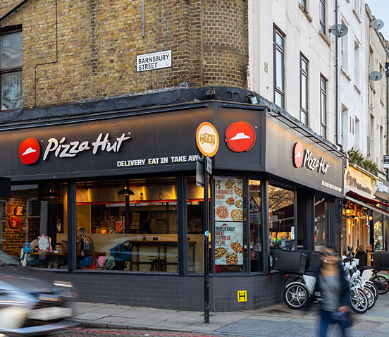
FINANCIAL
ANALYSIS

Slide 13

Sales Projections
$ 14 B
$13.522 B
3.5%
1.3 %
Gross Margin
40%
$13.352 B
$12.955 B
3 %
2021
2022
20232023
2024
Net Margin
8%

Slide 14
Revenue & Profit
10% Projected profit
60% Projected Gross Profit
3.5% Revenue Growth
Yearly Revenue
Yearly Gross Profit
Yearly Profit

Slide 15

Market Opportunity
30% Market Share
2500 stores
$26 B
(2028)
South America
Africa
West Asia
*Current Market Size: $19 Billion
*Current Market Share: 23%
HOUSEHOLD INCOME
Potential growth of 10-12% increase by 2028
*Current Number of Stores: 19,866 Stores

Slide 16
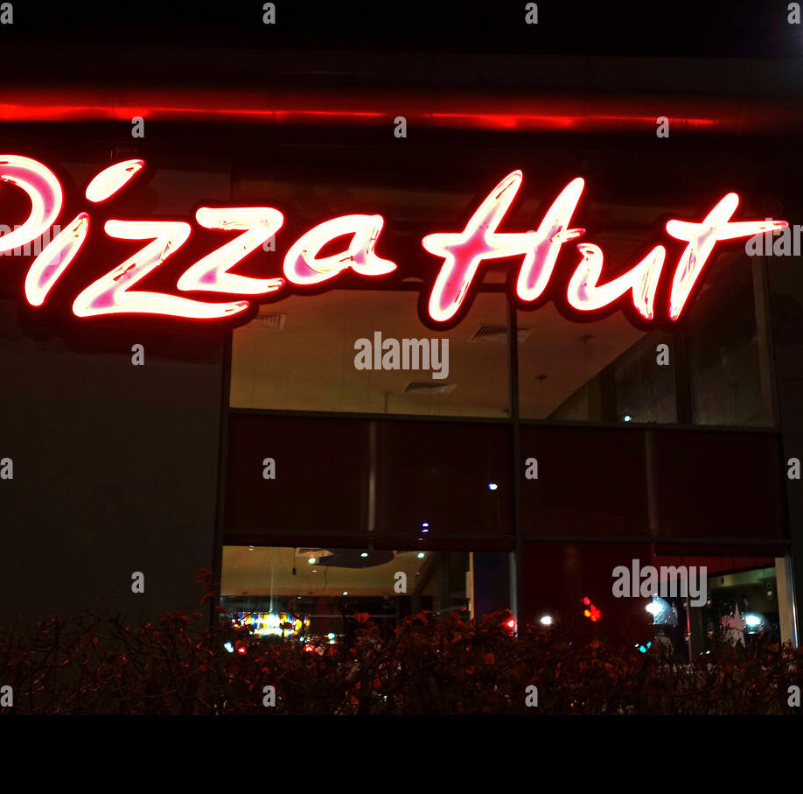
.
FUNDING REQUIREMENTS

Slide 17
$ 5 MILLION FOR
0.02% OF THE COMPANY
ASKING VALUATION:
$25 BILLION

Slide 18

Funding
FUNDING ROUND OF $ 25 MILLION
ASSURED 10 % ROI 3rd YEAR ONWARDS
$ 2,000,000 NET ANNUAL CASHFLOW
AVERAGE PAYBACK PERIOD OF 3.018 YEARS
Company Valuation: $ 25 Billion
0.1%
3.018
10 %
Equity Dilution
Discounted Payback Period { Years }
Return on Investment
*Discount Rate: 10 %

Slide 19
Use of Funds
Technology Deployments
15 %
Maintenance & Support
10 %
20 %
Hardware & Equipment
Land Acquisition
30 %
Contents Here
15 %
10 %
Distribution Channels
Marketing & Promotion

Slide 20
THANK YOU

